Slide 1

Final Project Phase -II Review Presentation & Demonstration on “Cricket Chatbot using Dialogflow”
Students:
1. Ashish R (1RN17CS021)
2. Chakravarthy C (1RN17CS029)
3. Chandan Raj N (1RN17CS030)
4. Nishith R Kashyap (1RN17CS059)
Guide:
Prof. Hemanth S
Associate Prof. Dept. of CSE, RNSIT
Department of Computer Science and Engineering
RNS INSTITUTE OF TECHNOLOGY
2020-21

Slide 2
CONTENTS
INTRODUCTION
Problem Statement
Existing System and Limitations
Proposed system
REQUIREMENTS
Functional Requirements
Non-functional Requirements
Hardware & Software Requirements
SYSTEM ARCHITECTURE
System architecture
DETAILED DESIGN
Dataflow diagram
Libraries used / API’s
IMPLIMENTATIONS
Methodology
RESULT ANALYSIS
Snapshots
CONCLUSION AND FUTURE WORK
Conclusion
Future work to be carried out
REFERENCES

Slide 3
INTRODUCTION
Problem Statement
Creating a centralized chatbot that services all cricketing queries from a single platform.
Existing System and Limitations
Some of the mentionable chatbots that service a cricket fan include Roanuz, Cricket bot (Discord), Cricbuzz chatbot, Circle of Cricket and Machaao for Cricket, among others. Disadvantage with the above mentioned chatbots are that they are very platform specific. We must visit the respective platform to access that chatbot. This might serve to be a hindrance to the user.

Slide 4
INTRODUCTION
Proposed system
The proposed system is focused on building a one-stop chatbot to service all kind of requests from cricket fans. By one-stop we mean the chatbot can respond to user requests by channeling data from various sources. The proposed chatbot can be integrated on multiple platforms. This aims at bringing the chatbot to the user rather than user to the chatbot.

Slide 5
REQUIREMENTS
Functional Requirements
Simple and Conversational.
Flexible Data Connections.
Multi-Channel Capability.
Easy Handling.
Non-functional Requirements
User Interface
Scalability
Security
Third Party Interaction

Slide 6
REQUIREMENTS
Hardware Requirements
Processor: Pentium4
Processor Speed: 2.4 GHz or above
RAM: 1GB or above
Storage Space: 512MB
Monitor Resolution: 1024x768
Software Requirements
Operating System: Windows 10
IDE: Visual Studio Code
Tech Stack: Node JS, Express
Tools: Dialogflow, Ngrok

Slide 7
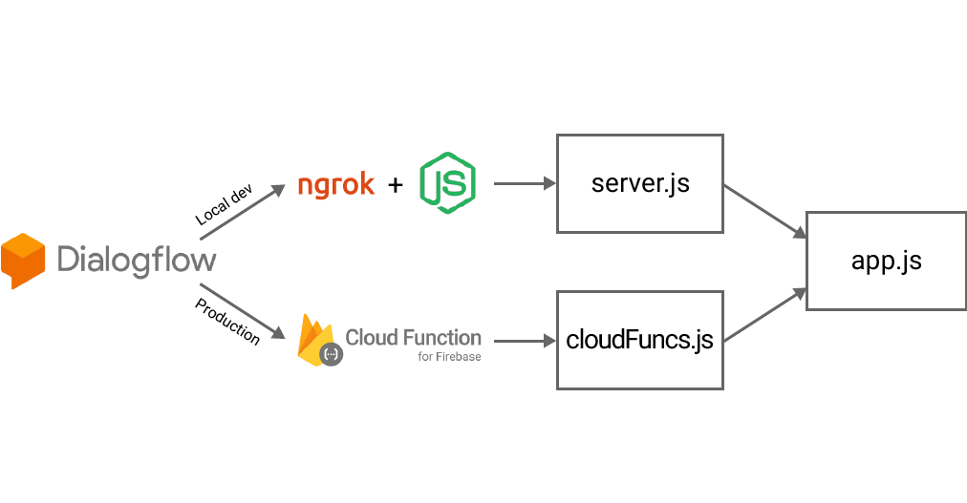
SYSTEM ARCHITECTURE
System architecture

Slide 8
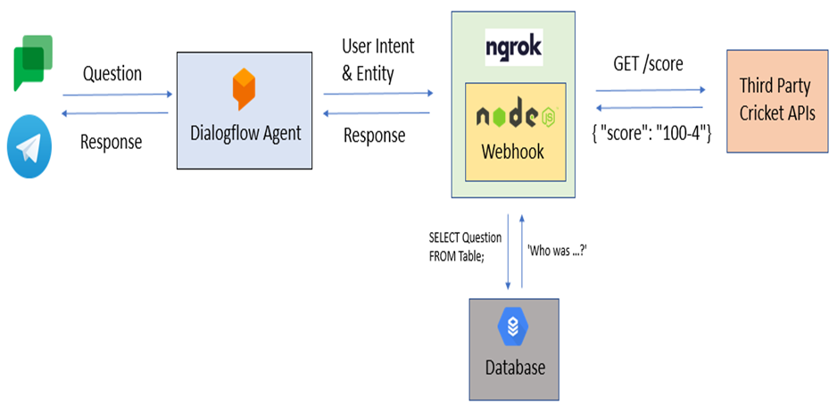
DETAILED DESIGN
Dataflow diagram

Slide 9
DETAILED DESIGN
Libraries
Cheerio
Axios
ChartJSNodeCanvas
Dialogflow Fulfillment
Cron
API’s
Sportsmonk
Cricapi
News API
Rapid API
Cricket API

Slide 10
IMPLEMENTATION
Methodology
Data Gathering
Pre-Processing
Dialogflow
Fulfillments using webhooks
Processing
Sending back the data

Slide 11
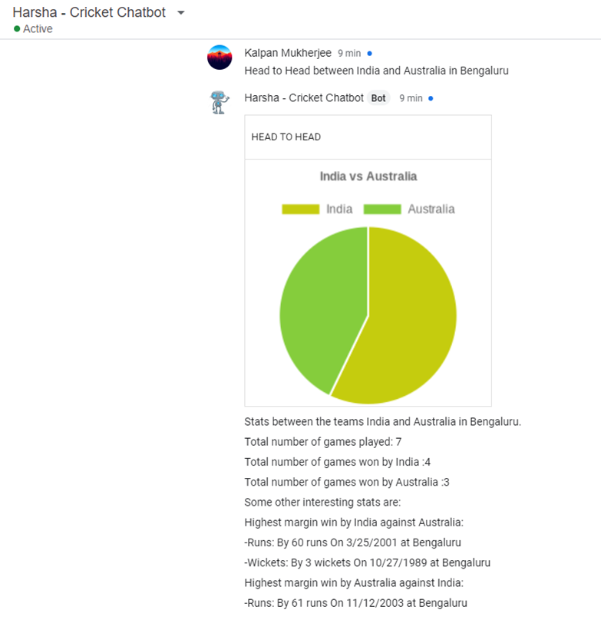
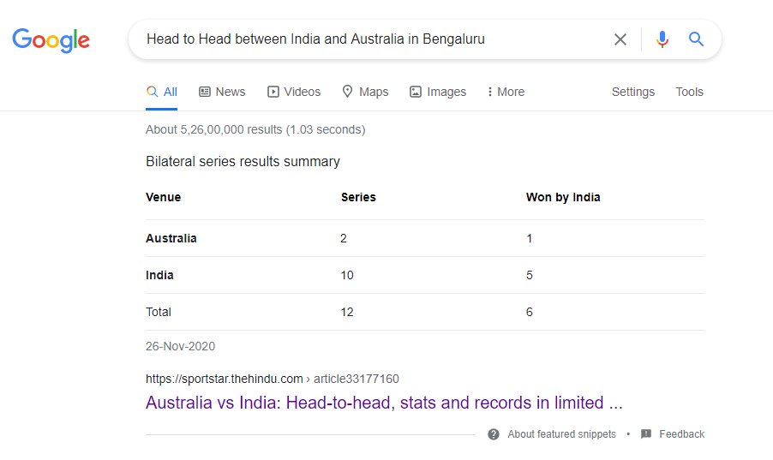
RESULT ANALYSIS
Head-to-head between Teams

Slide 12
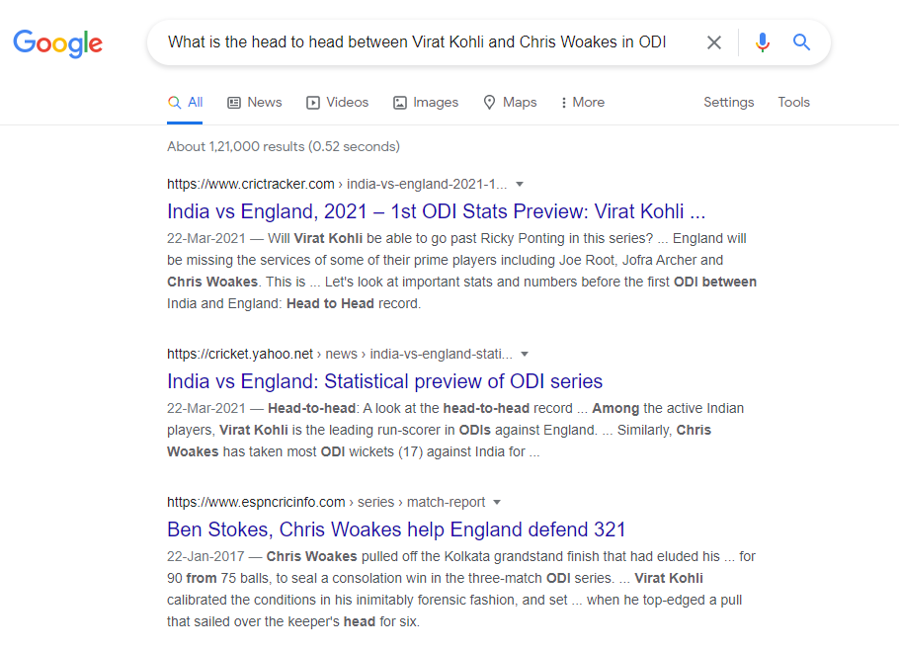
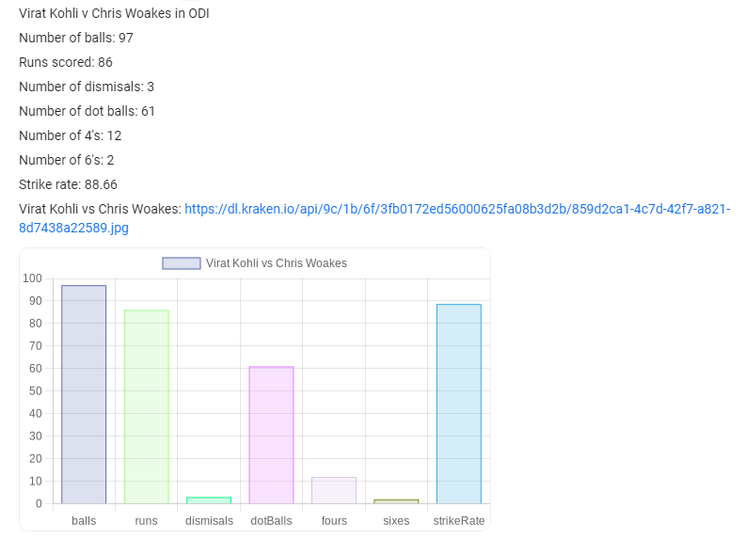
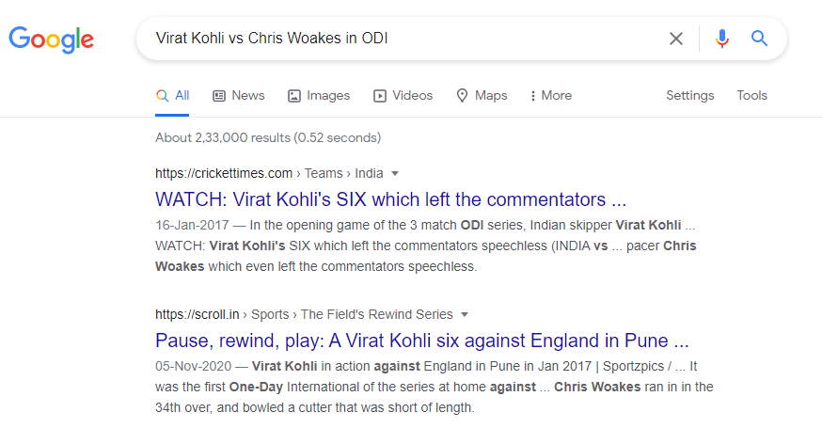
RESULT ANALYSIS
Player Head-to-head

Slide 13
CONCLUSION AND FUTURE WORK
Conclusion
Our application is one of the most unique cricket chatbot that is built. It acts as a single point source to query all types of cricketing questions. By fetching data from almost all sources available, this application has the capability to act in a very efficient manner to get your cricketing question answered. Certain information that would require the prior knowledge of the user to know where to look can be eliminated with this chatbot. Multiple clicks on google can be cut down to one click here. Using dialogflow reduces the burden of creating an NLP model of our own.

Slide 14
CONCLUSION AND FUTURE WORK
Future work to be carried out
Set up pipeline to update database
Interactive games
Leaderboard for hand cricket
Integrate with more platforms
Live commentary
Calendar integration for reminders
Follow teams or players

Slide 15
REFERENCES
[1] “IPL Complete Dataset | Kaggle.” https://www.kaggle.com/patrickb1912/ipl-complete-dataset-20082020
[2] CricAPI, https://www.cricapi.com/
[3] SportsMonk, https://www.sportmonks.com/
[4] NewsAPI, https://newsapi.org/s/india-sports-news-api
[5] ESPN Cric Info, https://www.espncricinfo.com/

Slide 16

PROJECT SETUP AND DEMONSTRATION

Slide 17
Suggestions….!

Slide 18
THANK YOU!!!

